Slide 1
1-dimensional traveling waves in neural minicolumns
Vincent Baker
Drexel University Department of Physics

Slide 2
Introduction
Traveling waves of cortical neuron activation have been observed in vivo, in vitro and in silico. Proposed functions of these traveling waves include motor coordination, place field coordination in the hippocampus, and spatiotemporal processing in the visual cortex. Advanced experimental techniques that achieve the required spatial and temporal resolution to capture the mesoscopic traveling waves have focused on lateral activity near the cortical surface, and simulations of cortical traveling in a 2-D sheet of neurons have been performed. In this work we explore the dynamics of traveling waves along the vertical column structures found in the cortex.
We find that 1-D traveling waves can propagate in simulated neural microcolumn structures with certain properties including distance-dependent connectivity and a mix of excitatory and inhibitory neurons. We observe wave properties including creation from background stimulus, annihilation between waves, and a wave group velocity that is determined by both the neural phase velocity (action potential propagation speed) and the column topology. The topological dependence of wave speed is especially interesting as it may contribute to the functional organization of the cortex into microcolumns and .

Slide 3
Methods

Slide 4
Neuron and Synapse Dynamics
Izhikevich model for neuron dynamics
2-D model that captures key dynamical behavior
Randomization of model parameters
Excitatory and inhibitory neurons
Synapse response model is an exponential decay with a delay
Simulated in MATLAB

Slide 5
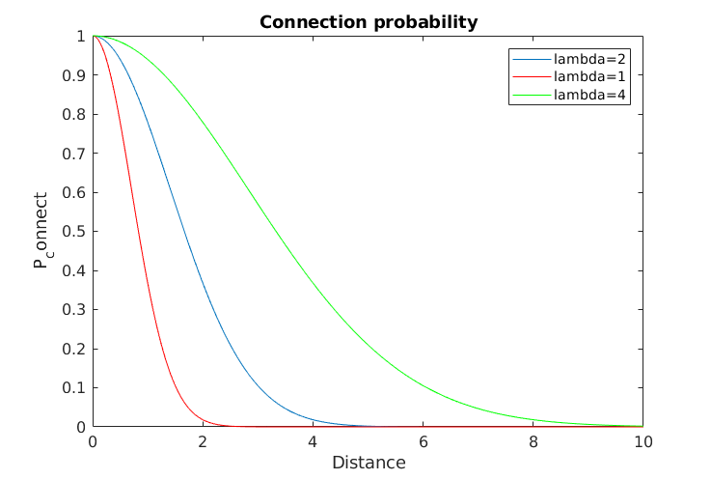
Neuron Connectivity
Distance-based exponential

Slide 6
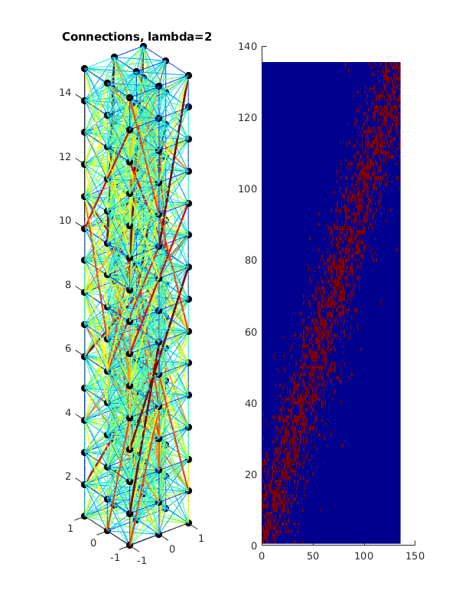
Column structure
Neurons on a unit spacing
Column topology defined by x-y cross section and z height, waves travel along z axis
Neurons are connected probabilistically using distance model with exponential decay, high local connectivity with sparse long-distance connectivity
Z axis
3x3x15 column

Slide 7
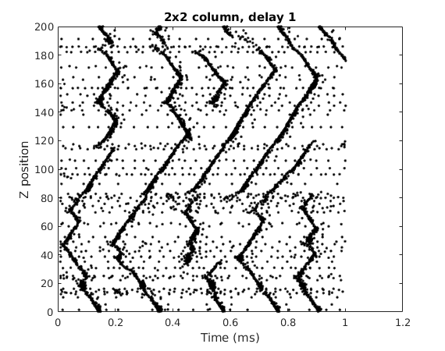
Traveling waves
We plot the neuron firings over time, with one black mark per firing event
We plot each neuron firing at the Z position of the neuron. There are multiple neurons at each Z position so there can be overlapping marks
Wave collision and annihilation
Background firing activity defined as firing events that are not part of a wave structure
Traveling wave initiation

Slide 8
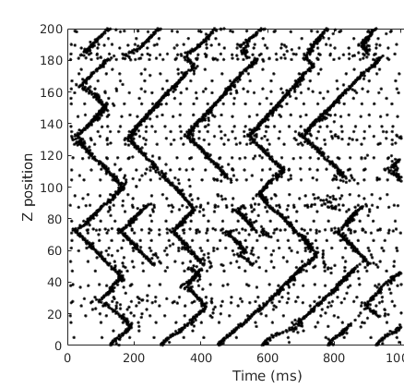
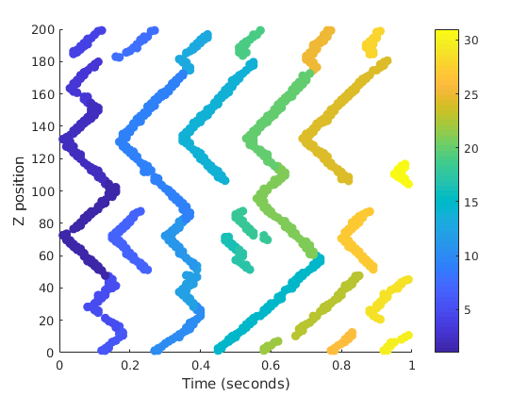
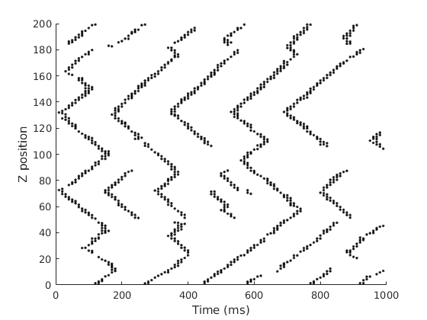
Wave detection and labeling
Firing events
High density regions
Waves
Filter
ID
Detection process first filters raw firing events to discard background firing
Plane sweep algorithm identifies wave initiation points, groups firing events into waves

Slide 9
Results

Slide 10
Properties
Wave initiation from background stimulus
Propagation velocity
Delay parameter
Connectivity parameter
Column topology

Slide 11
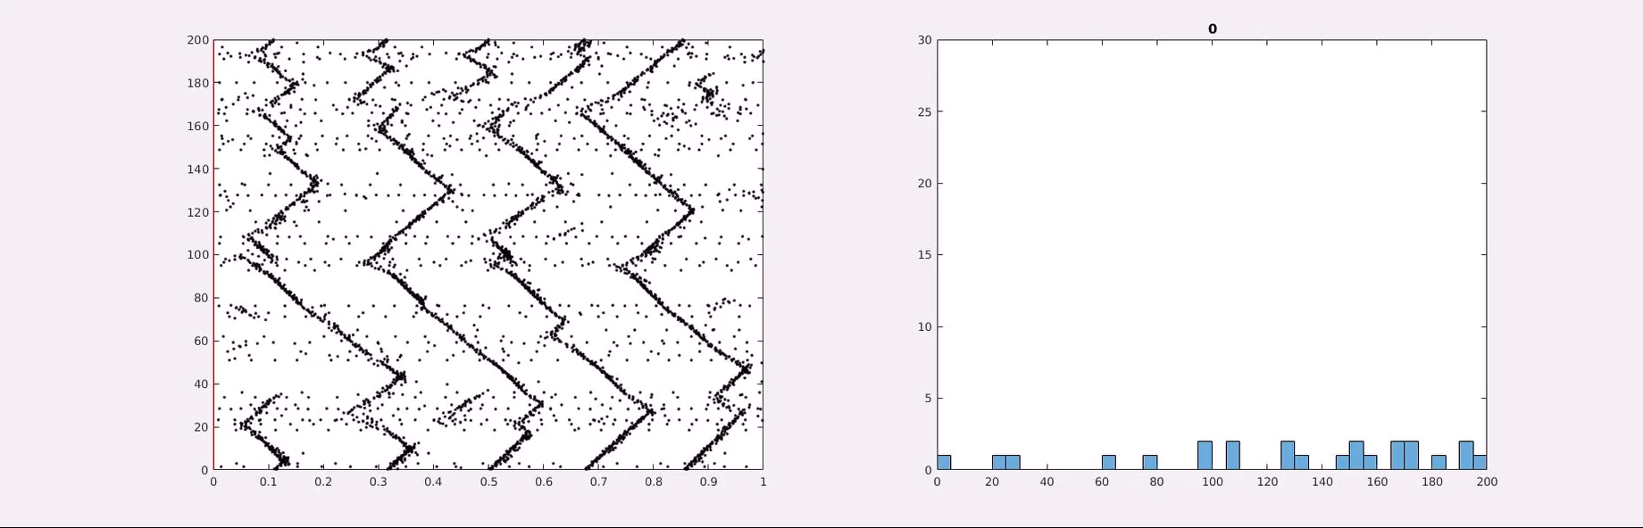
Wave initiation
Traveling waves emerge from uniform random stimulus of entire column
Certain sites seem to be preferential for wave initiation

Slide 12
Wave propagation speed

Slide 13
Notes
Exponential connectivity with increasing lambda
Higher lambda makes fatter, faster waves
At critical value we see re-firing
Wave separation?
Normal connectivity
Higher range connectivity makes fatter, faster waves
At critical value we see re-firing
Wave separation?
Paper #1 – Narrative with figures
Traveling waves in 1-D systems (2x2, 3x3)
Behaviors by parameters: annihilation, echo, density/initiation correlation, phase space of connectivity/delay for velocity, delay behavior is normal, connectivity behavior
Paper #2: Column ensembles with Joe’s delta parameter

